Slide 1
RL seminar
Boyeon, Kim
2023. 11. 9.

Slide 2
Done List
SLIAR
Best Control Check
DQN Control Check
Code

Slide 3
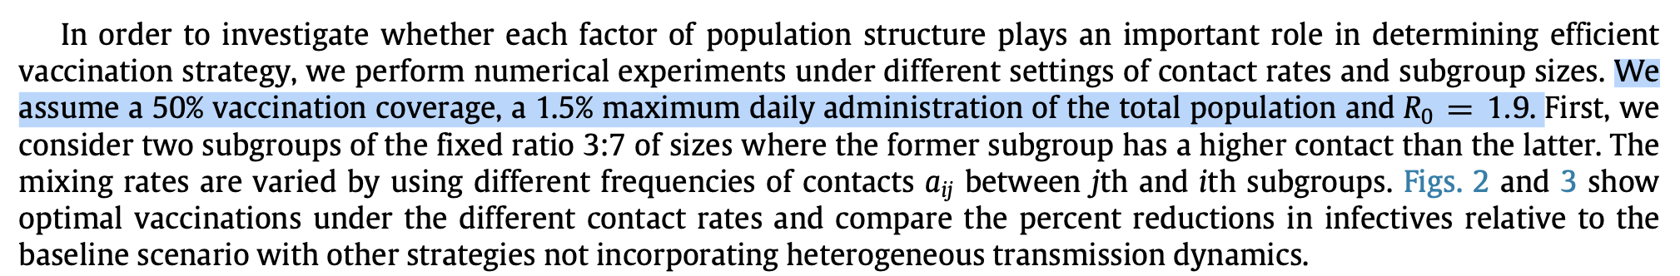

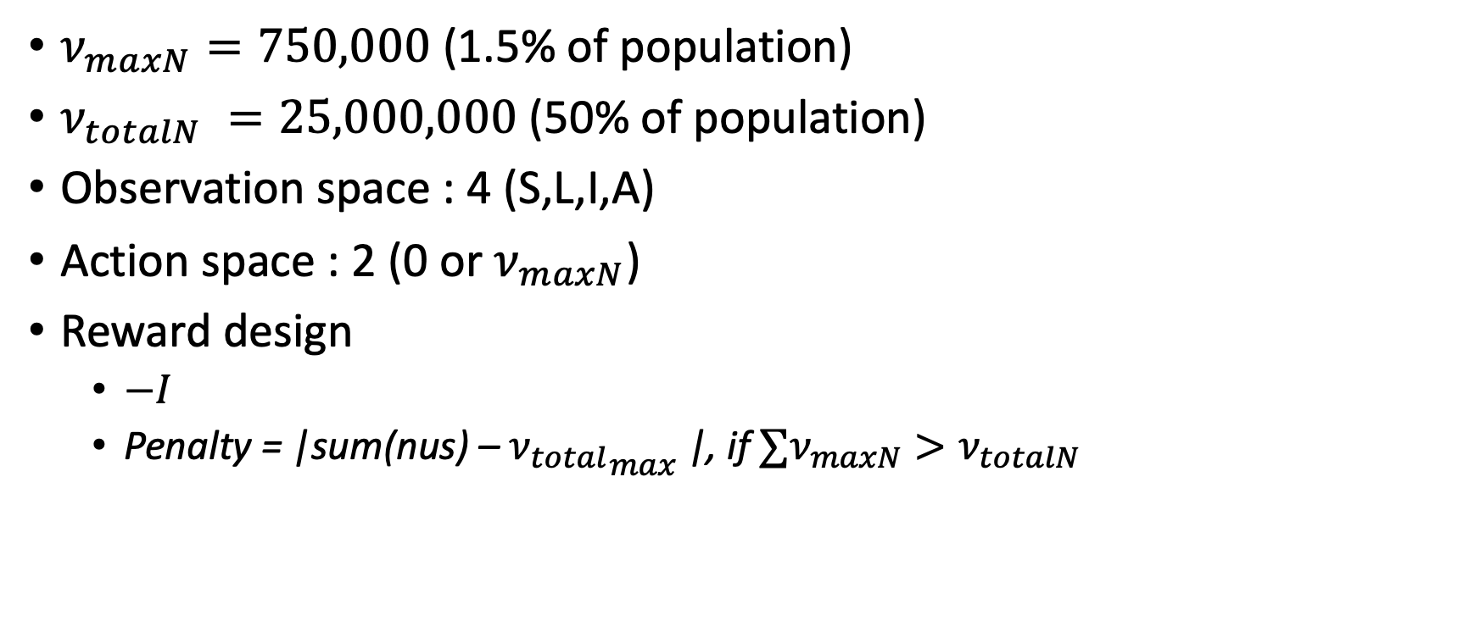
Set the environment for DQN in SLIAR
Reward : $`−I`$
$ν_{maxN}⁡=750,000$ (1.5% of population)
$ν_{totalN} =25,000,000$ (50% of population)
Observation space : 4 (S,L,I,A)
Action space : 2 (0 or $ν_{maxN}$)
Reward design
$−I$
Penalty = |sum(nus) – ${ν_{total}}_{max}$|, if $∑ν_{maxN}>ν_{totalN}$

Slide 4
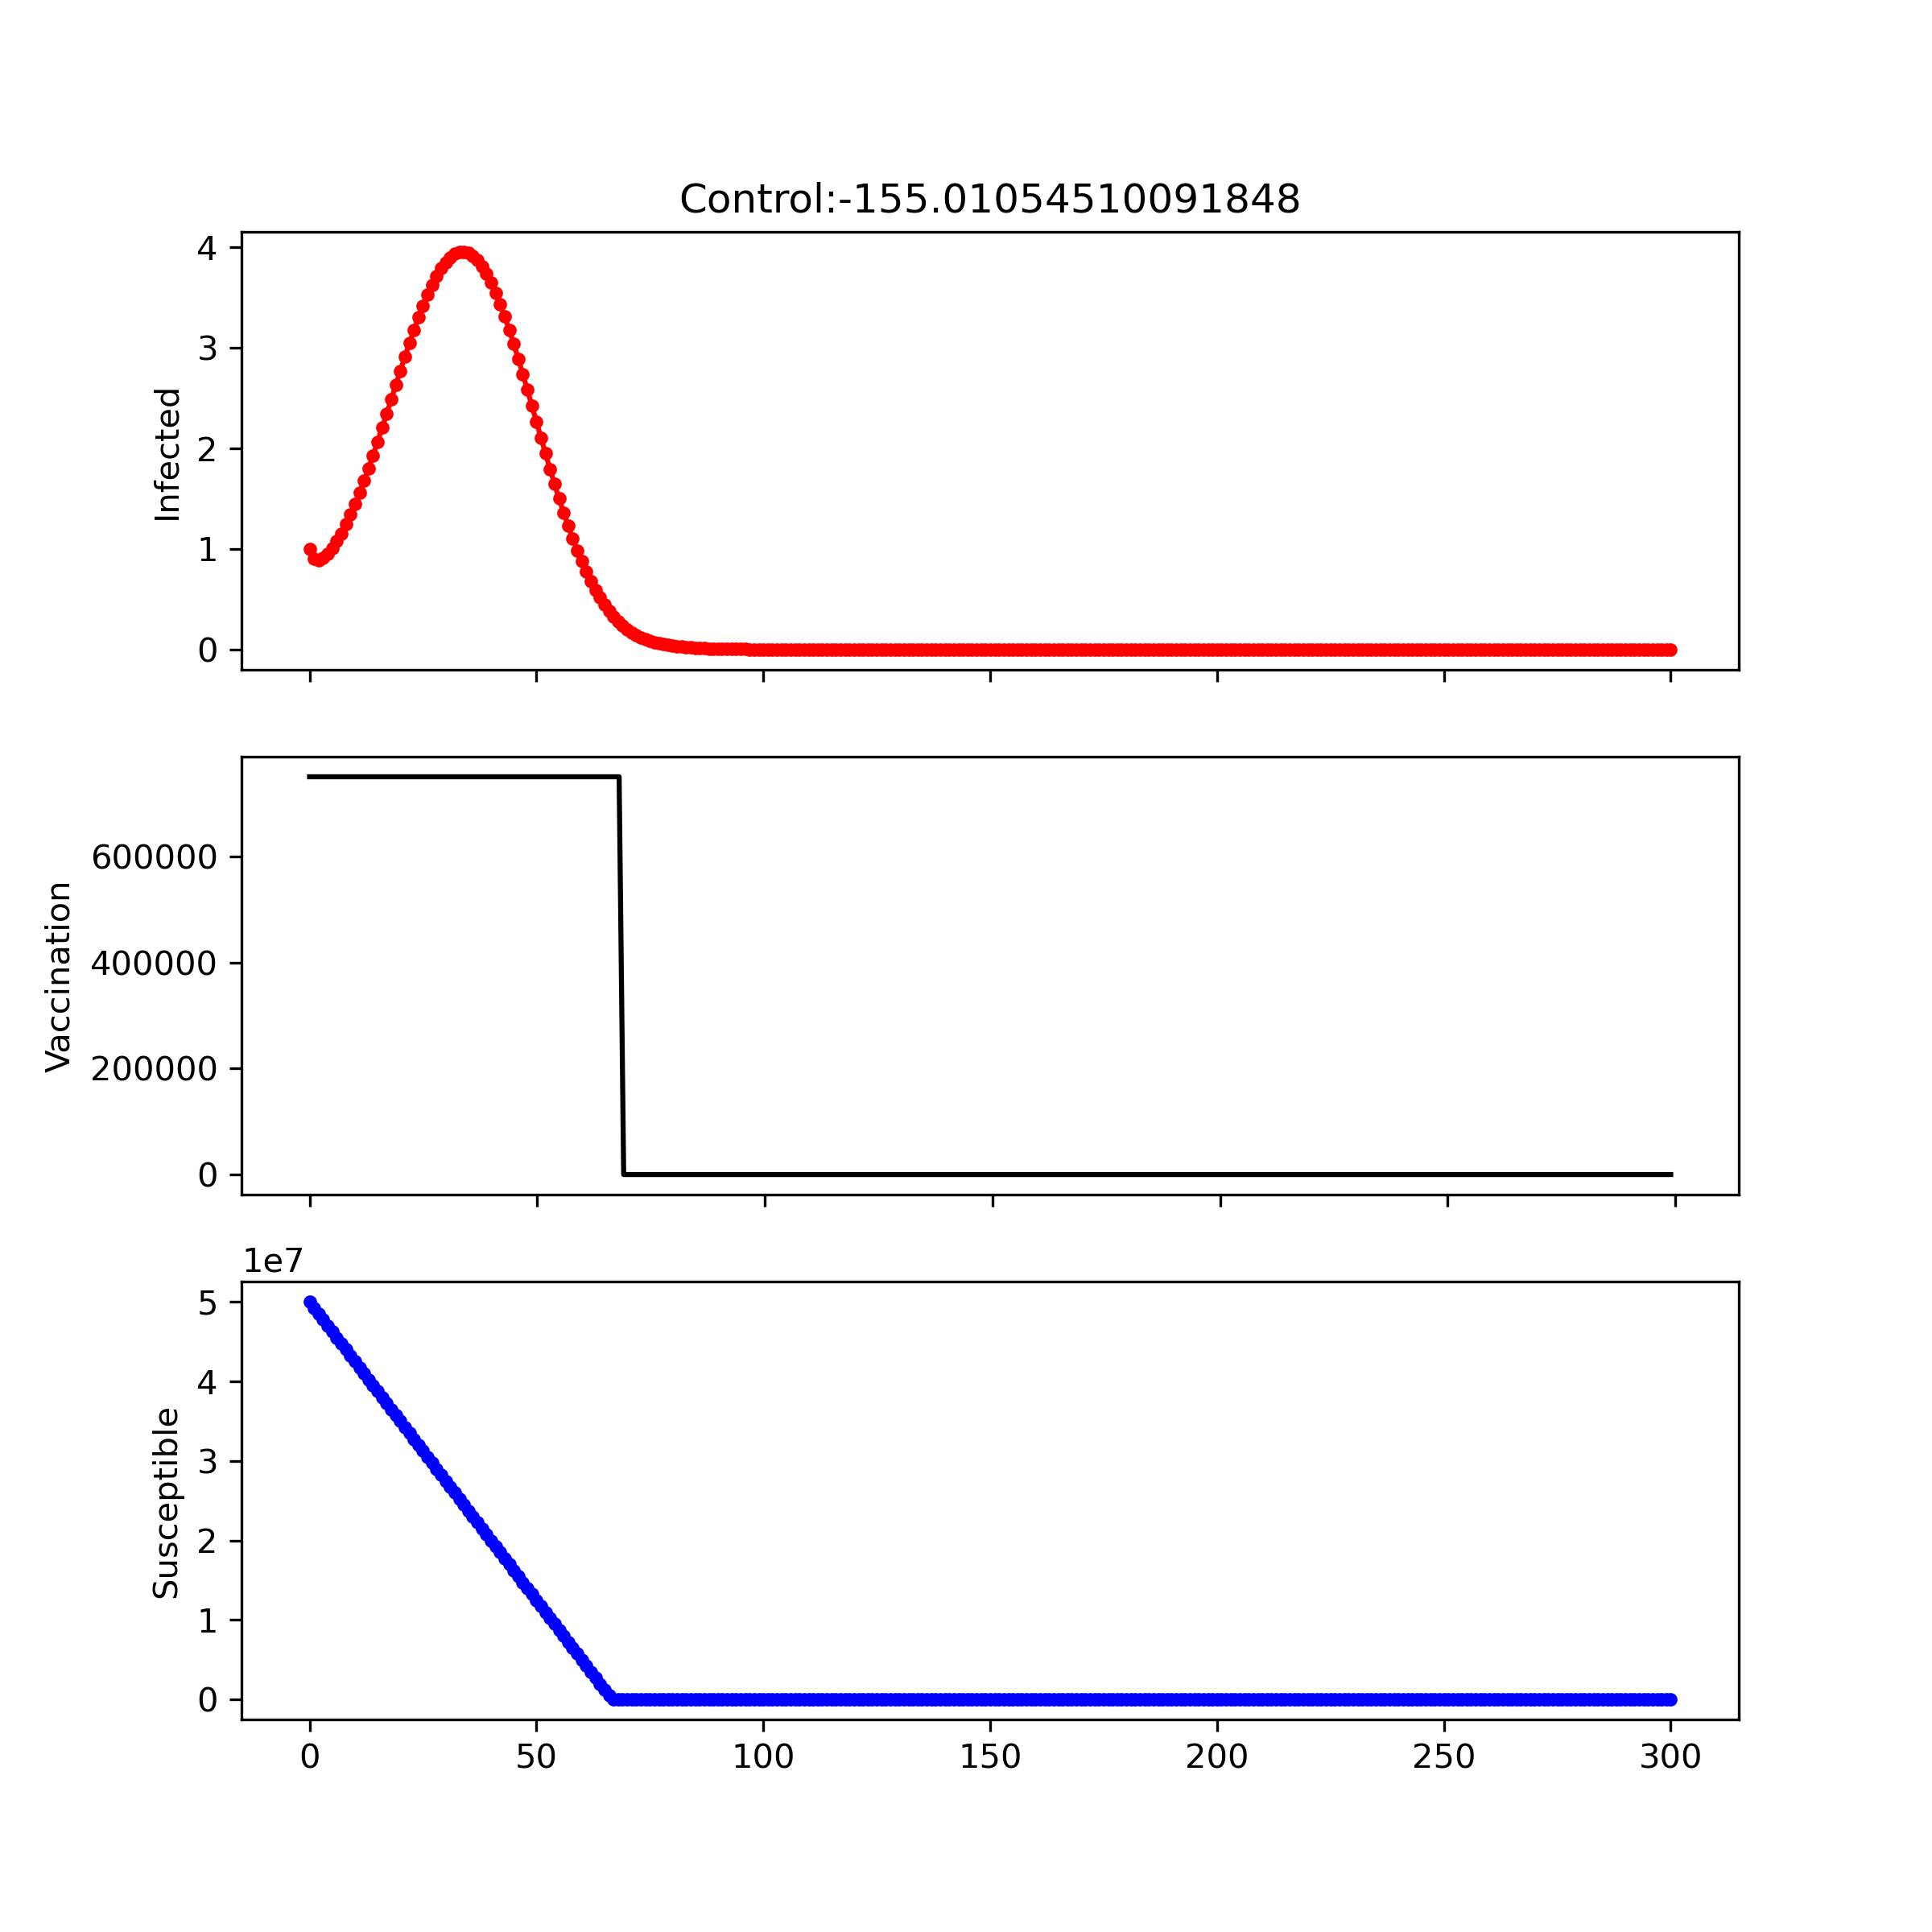
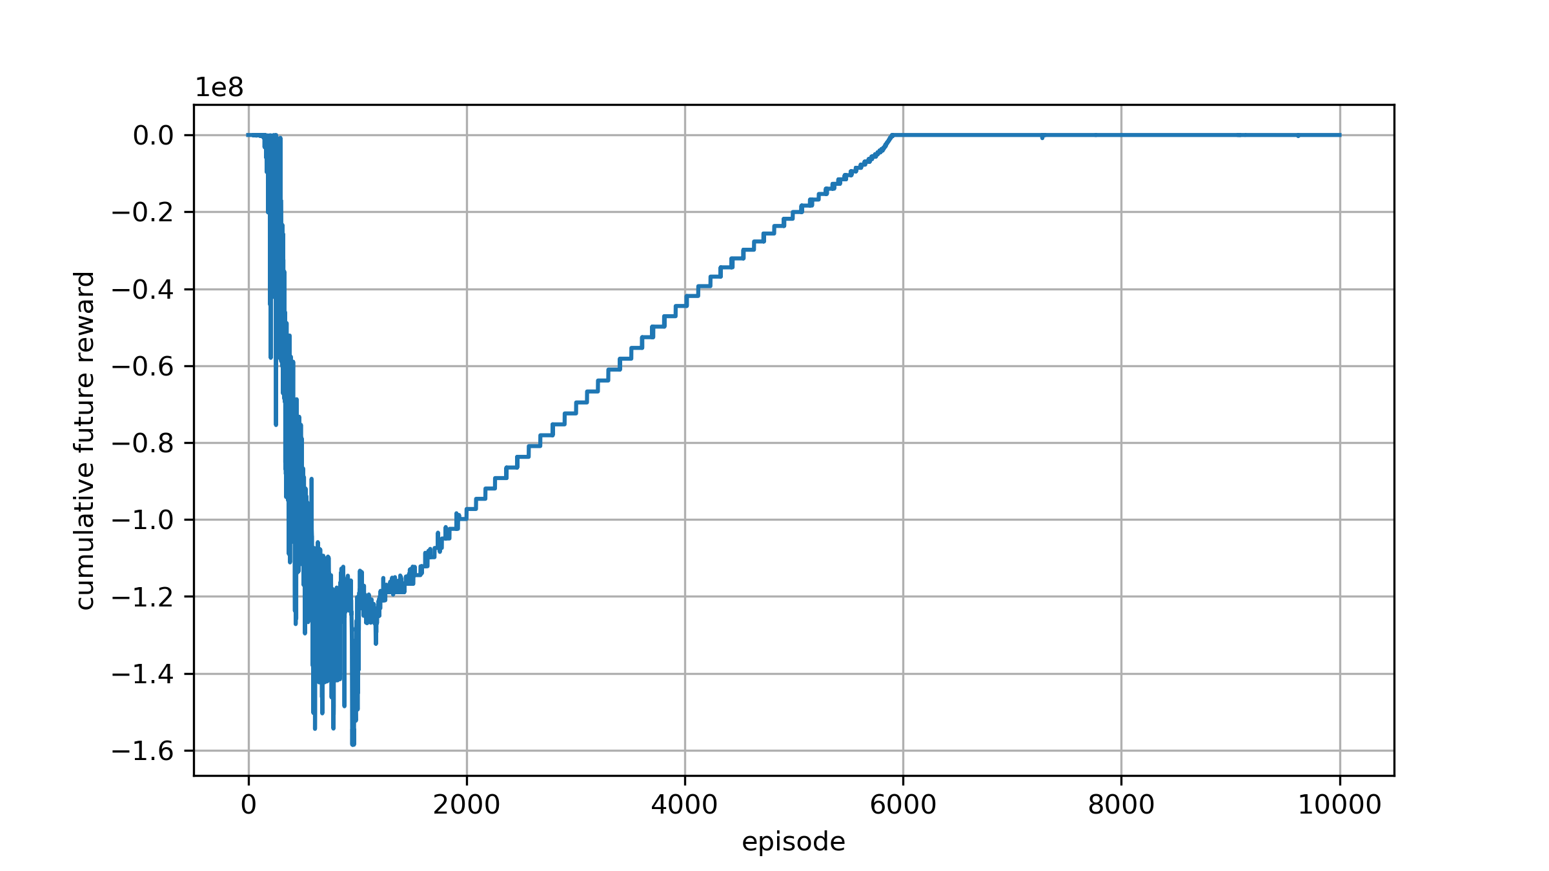

Learning rate : 1e-6 Reward design : −𝑰 Network initial : `default` Scale = 1
Reward : $`−I `$
Notes:
67days : full vaccine
750,000 * 66 = 49,500,000
750,000 * 67 = 50,250,000 약 5천만
Network : self, state_size, action_size, seed, fc1_units=64, fc2_units=64, fc3_units=64, fc4_units=64):

Slide 5
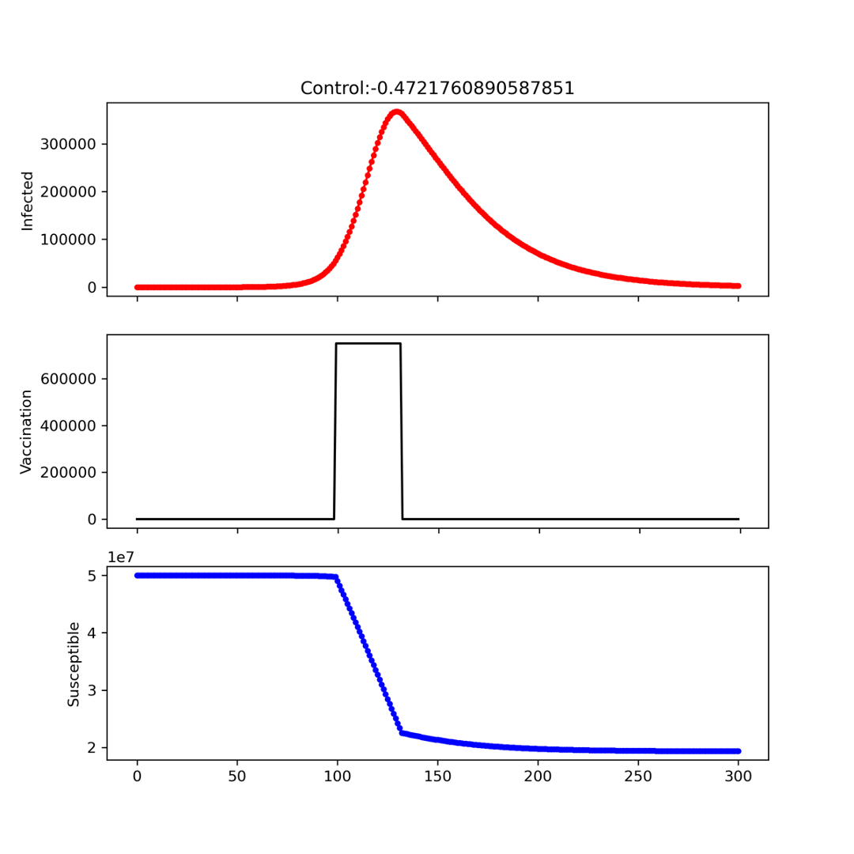
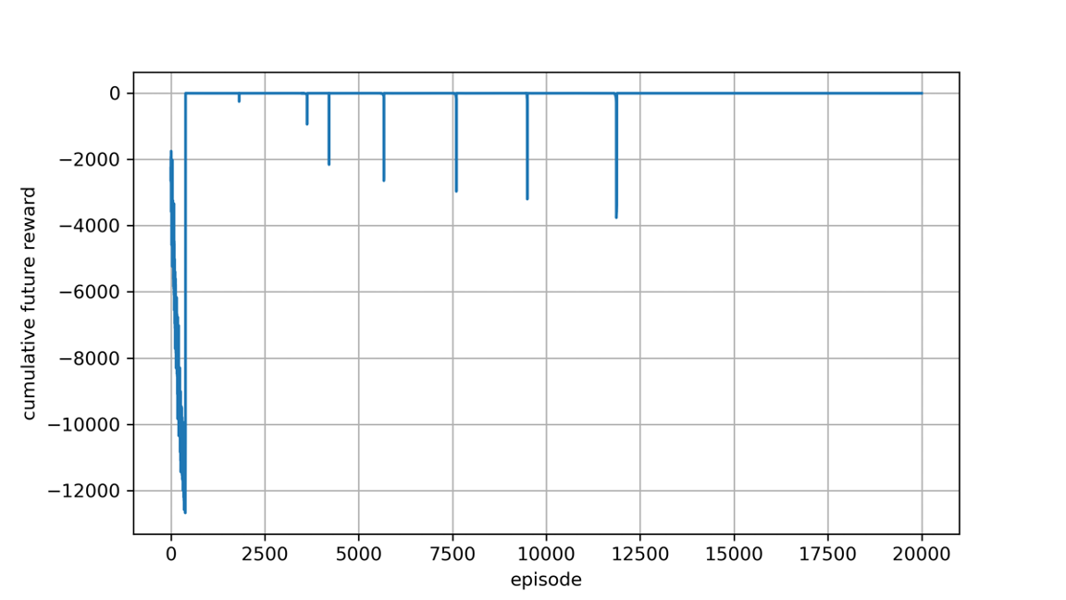
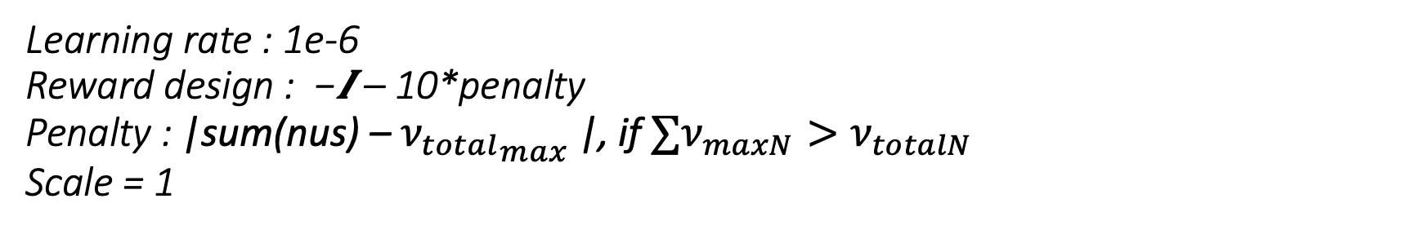

Learning rate : 1e-6 Reward design : −𝑰 – 10*penalty Penalty : |sum(nus) – ${ν_{total}}_{max}$|, if $∑ν_{maxN}>ν_{totalN}$ Scale = 1
Reward : $`−I−penalty `$
Notes:
67days : full vaccine
750,000 * 33 = 24,750,000
34일째부터 penalty

Slide 6
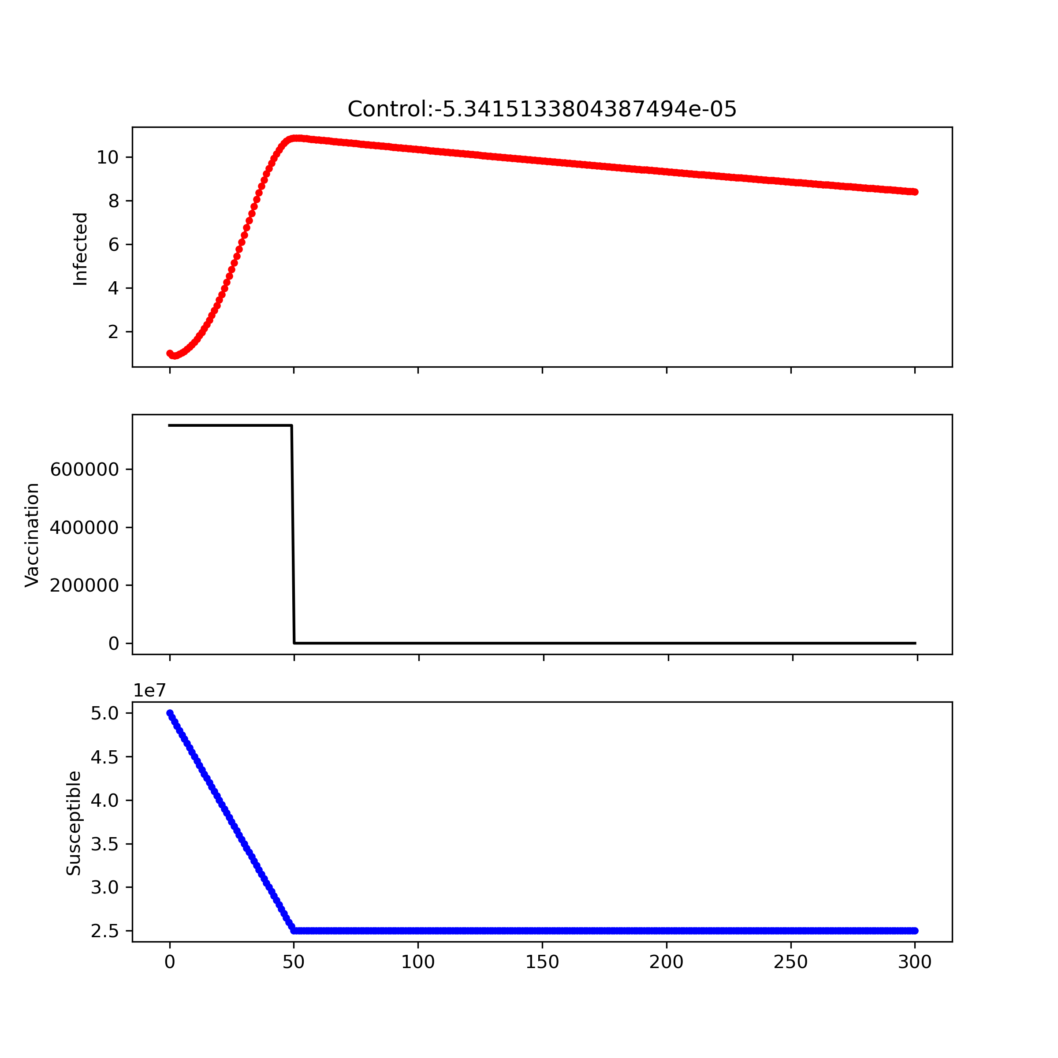
Best Control
Reward : $`−I−penalty `$
Notes:
Best control
우리가 best라고 믿고 있는

Slide 7
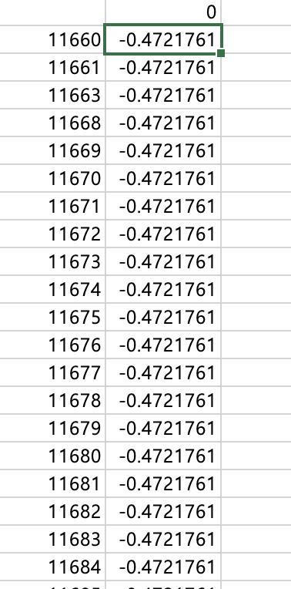
Score log and action log
Reward : $`−I−penalty `$
381 | 1 | 1 | 1 | 1 | 1
379 | 1 | 0 | 1 | 1 | 1
343 | 1 | 1 | 1 | 1 | 1
350 | 1 | 1 | 1 | 1 | 1
347 | 1 | 1 | 1 | 1 | 1
344 | 1 | 1 | 1 | 1 | 1
348 | 1 | 1 | 0 | 1 | 1
352 | 1 | 1 | 1 | 1 | 1
383 | 1 | 1 | 1 | 1 | 1
338 | 1 | 1 | 1 | 1 | 1
355 | 1 | 1 | 1 | 1 | 0
363 | 1 | 1 | 1 | 1 | 1
370 | 1 | 1 | 1 | 1 | 1
373 | 1 | 1 | 1 | 1 | 1
382 | 1 | 1 | 1 | 1 | 1
322 | 1 | 1 | 1 | 1 | 1
332 | 1 | 1 | 1 | 1 | 1
333 | 1 | 1 | 1 | 1 | 1
378 | 1 | 1 | 1 | 1 | 1
380 | 1 | 1 | 1 | 1 | 1
299 | 1 | 1 | 1 | 1 | 1
310 | 1 | 1 | 1 | 1 | 1
323 | 1 | 1 | 1 | 1 | 1
349 | 1 | 1 | 1 | 1 | 0
Notes:
Best control
우리가 best라고 믿고 있는

Slide 8
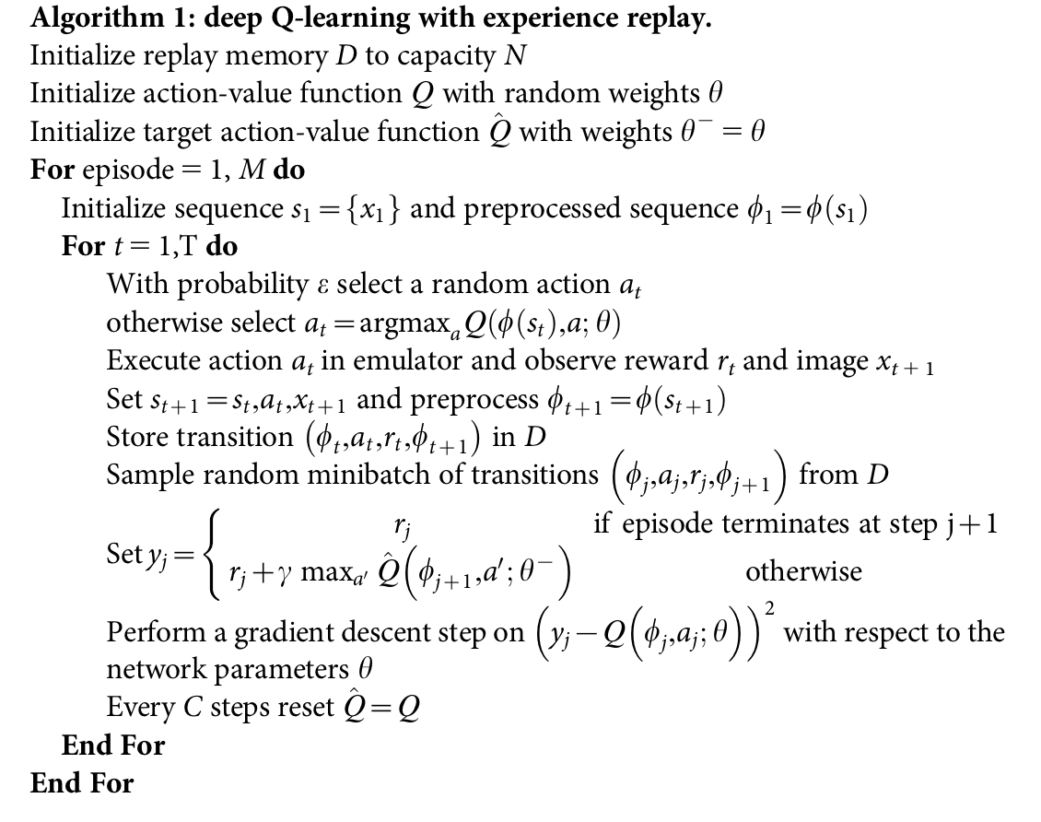
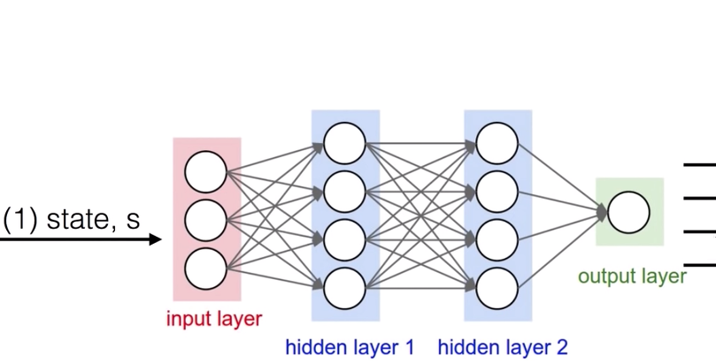
DQN Algorithm
Goal : Initial weight = Best Control Initial
Q-value
Notes:
67days : full vaccine
750,000 * 66 = 49,500,000
750,000 * 67 = 50,250,000 약 5천만

Slide 9
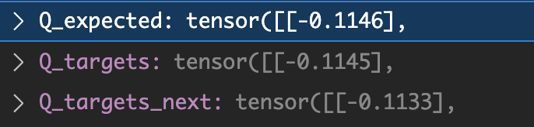
How to do?
Step 1 : Best control의 Q-value값 계산 (단순 Q-value function 식을 통해)
Step 2 : Step1 값과 동일한 값이 나오도록 weight 학습(?)
Step3 : 그 weigth로 initial 사용
Step4 : 학습
Step2: (현재) 64개 batch에 대한 값들이 Q값 생성
(Todo) Q-target에 Best control Q-value 값 대입
Notes:
67days : full vaccine
750,000 * 66 = 49,500,000
750,000 * 67 = 50,250,000 약 5천만

